Slide 1

WELCOME BACK TO
MONEY BASICS
Facilitated by:
[Facilitator 1 name]
[Facilitator 2 name]

Slide 2
Debit, ATMs, Online Banking & Money Safety
Workshop 5
PG. 80 IN STUDENT GUIDE

Slide 3
Welcome Back!
Updates & Sharing:
How did the money saving homework go?
How are your budgets going?
What bank fees did you find?
Today’s Agenda:
Learn about debit cards -- how they work, common questions, and how to prevent debit card fraud.
Learn about ATMs and ATM Safety.
Learn about online banks, their pros and cons, and mobile banking options.
Learn about direct deposit, Social Security payment options, and online bill payments.
Learn about money safety tips, how to protect yourself from identity fraud, and what to do if your identity or banking information has been stolen.

Slide 4
Community Agreements

Slide 5
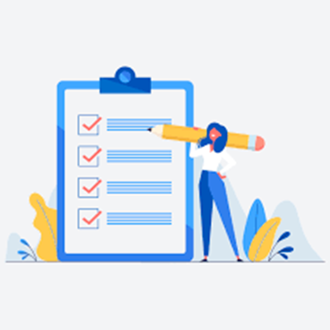
Learning Objectives
Upon conclusion of Workshop 5, participants will:
Understand how debit cards work and how to safely use them
Know how to use an ATM and know basic safety tips/how to recognize potentially dangerous situations
Have an understanding of online banking and available online options, Direct Deposit, and how to utilize online tools and services
Have an understanding of mobile banking apps and mobile money transfer apps
Know how to utilize online and automatic bill paying
Know key money safety tips and tips to minimize the risk of identity theft

Slide 6
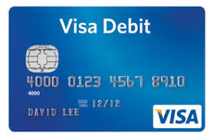
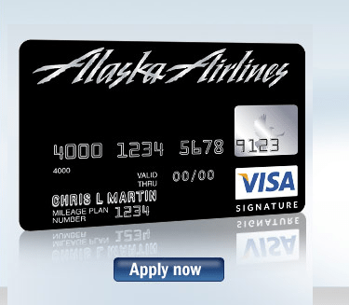
Debit Cards
How do debit cards work?
Debit cards run through scanners at stores that enable your financial institution to 1) verify electronically that the funds are available and 2) approve the transaction.
Debit cards also can be used at ATMs and stores to withdraw cash from your account
FAQs about debit cards:
Common costs and fees
Rewards and incentives

Slide 7
Money Safety Part 1: Debit Card Fraud
Tips to avoid the risk of debit card fraud:
Memorize your PIN instead of writing it down
Never give out your PIN and other banking information over the Internet unless you initiated the contact or you can verify the person is who they say they are
Don’t share your debit card PIN, security code, and other account information with friends or relatives, including friends made over the Internet
When pumping gas or making purchases, always stand so no one can see you enter your PIN on the keypad.
Be careful when using your debit card for online shopping
Check your bank statements periodically for any discripencies

Slide 8
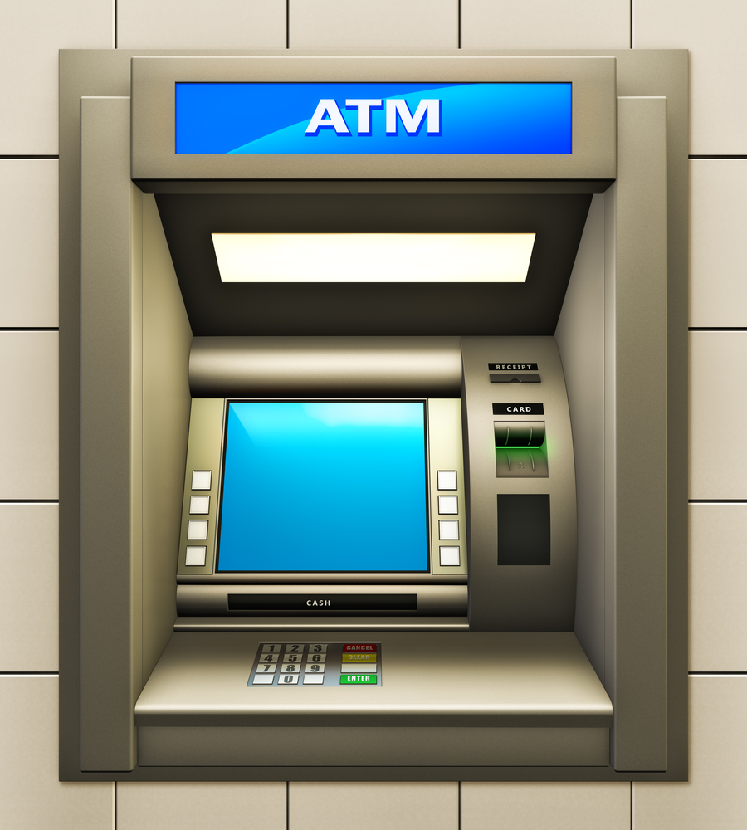
How to Use an ATM
Insert or swipe your card
Enter your PIN
Accept charges (if the ATM is unaffiliated with your bank)
Choose a transaction: Withdrawal or Deposit
Request or decline a receipt
Remove your card and your money (if you made a withdrawal)

Slide 9
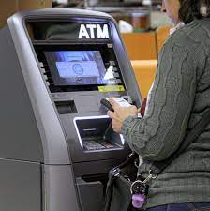
Activity: ATM Safety
Scenarios
A person attempting to use an ATM in a dark or secluded place.
While one person is using the ATM, another person shows up and begins peering over their shoulder.
The person who is about to use the ATM pulls out a piece of paper to read his or her PIN.
While one person is using the ATM, another person is persistent in offering to help.
Just as one person is about to use the ATM, they notice it looks different than it should.
After making a cash withdrawal ($200-$300), the person counts the cash in front of another nearby stranger.

Slide 10
Money Safety Part 2: ATM Safety Tips
Use an ATM in the center of a well-lit, public location. Bring another person with you, if possible.
Maintain awareness and be wary of people trying to help you with your transaction.
Don’t use an unusual-looking ATM
Don’t allow people to look over your shoulder as you enter your PIN
Don’t bring any valuables to your ATM transaction
Never count your cash in public
At a drive-up ATM, keep your engine running and your doors locked
Prepare your deposit paperwork ahead of time
Closely monitor your bank statements and balance and report any problems to your bank immediately
If you are involved in a confrontation, comply

Slide 11
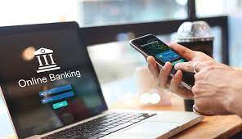
Online Banking
Your bank’s website or mobile app can allow you to:
Check your balance
View all transactions
Transfer money
Deposit checks
Open a new account
Other services by websites and apps to help with your financial needs include:
Budgeting
Paying bills
Sending and receiving money
Investing

Slide 12
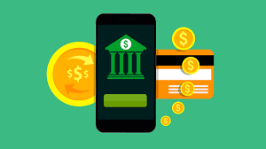
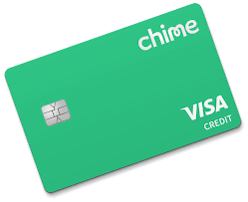
Virtual Banks
PROS:
CONS:
Lower fees
Better interest rates
Convenience
Accessibility
Efficiency
Start-up time
Difficulty depositing cash
Fewer options
Learning curve

Slide 13



Additional Online & Mobile Financial Services
Smartphone Applications:
Money Transfer apps
Venmo, CashApp, Paypal, Zelle
Investment apps
RobinHood, Acorns, E*Trade
Budgeting apps
Mint, PocketGuard, TrueBill
Automatic Bill Pay:
You agree to let a company take money out of your account each month to pay your bill
Convenient and the best way to ensure you pay your bills on time
Make sure:
There are no fees attached
You have enough money in your account to cover the payment

Slide 14
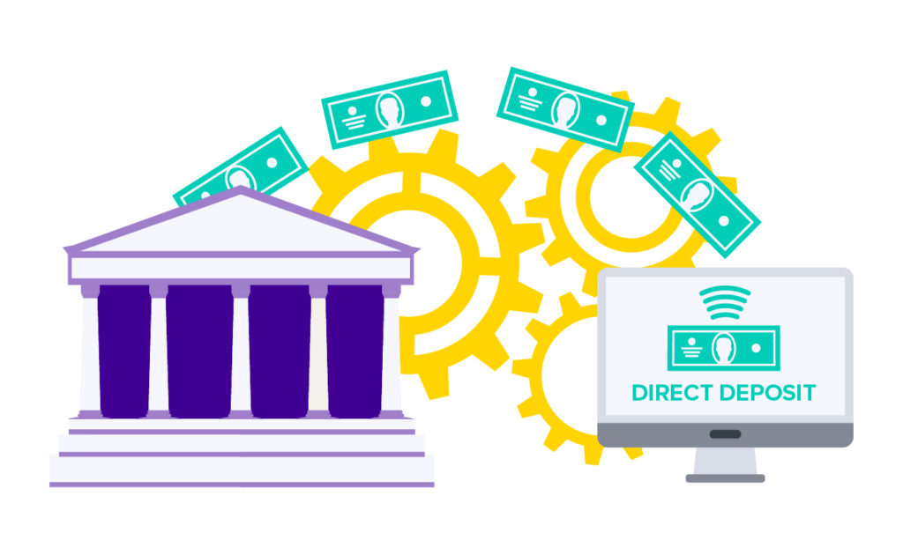
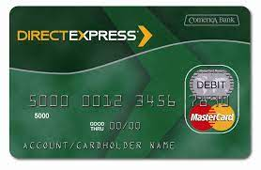
Direct Deposit & SSI Payments
Direct Deposit/ACH Payments:
Your employer can deposit your paycheck directly into your bank account, instead of writing you a check
All you need to do is provide your account number and bank’s routing number
Social Security Payments:
You can also receive Social Security payments using direct deposit or the Direct Express debit card

Slide 15
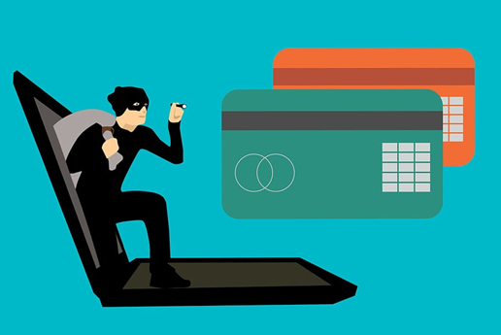

Money Safety Part 3: Safely Banking Online
Tips for safe banking over the Internet:
Read key information on the bank’s website
Make sure you are on the bank’s official website
Make sure the bank is insured under the FDIC. Look for this logo:

Slide 16

Money Safety Part 4: Identity Theft
Tips to avoid identity theft:
Protect your personal information
Review your account transactions and statements
Practice phone and internet safety
Take immediate action: report and freeze your accounts
Additional money safety tips:
Don’t carry large amounts of cash on you or in your home
Be watchful of your surroundings and do not show money you have on hand

Slide 17

Discussion
Are there any questions or comments about money safety?
Do you have any additional money safety tips or suggestions?

Slide 18

Wrap-Up
Thank you all for your participation!
Are there any questions?
Homework:
Choose one more money saving idea and commit to it for the week. Keep track of which ideas are going well and which are not.
Continue using your budget for the next week and revise it if needed.

